Slide 1
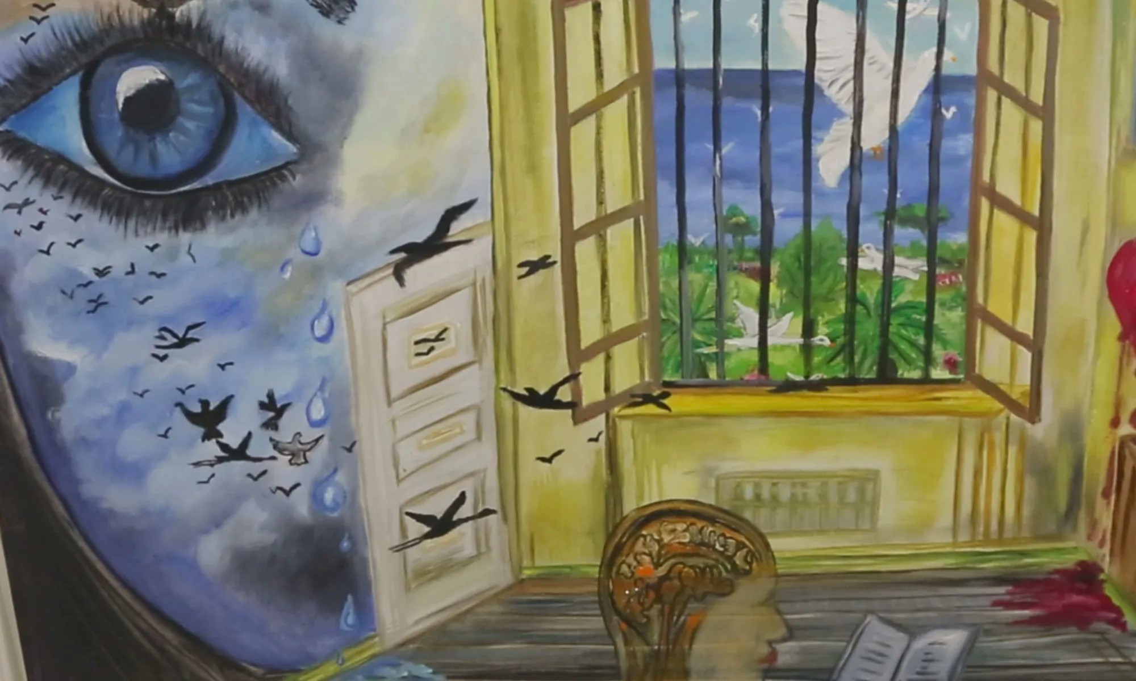
Living conditions in Greek prisons and the necessity of Education
Maria Kaminioti,
PhD Candidate University of Alicante
Introduction The role of the counsellor is crucial for the personal development of vulnerable groups. More specifically, it acts as a guide, leading the individual towards meaningful employment, independence and self-empowerment. Also, vocational counselling is about empowerment. It recognizes the unique talents and abilities of individuals and seeks to create opportunities for them to thrive in the workplace. In addition, counseling plays a key role in reintegration and preventing recidivism. Finally, career counsellors help to combat stigma and prejudice, promoting an inclusive society where diversity is recognised and valued.
Size of the sample
1 of the largest prison in Greece
1 second chance school in Grevena
4 prison officers, the manager of the prison and 1 sergeant
2 educators and 1 consulter
1 psychologist
1 social worker and the director of the secondary school
10 prisoners
What about the research
The current study will examine three different sections
The prison, the education and the counselling
Specifically,
The living conditions, the work and interests in the prison,
Consulting Goals. I aim to create a mini guide for the counsellors with advice and activities suitable for integration into the vocational guidance course
Counselor's role and the significance of education
Educational programs in the prison to prepare the social reintegration and reduce recidivism
Living conditions in prisons
These included very poor material conditions, lack of hygiene, the absence of an appropriate regime, high levels of inter-prisoner violence and intimidation as well as insufficient and inadequate medical care in prisons.
As regards the Trans women are offered a few opportunities to participate in activities such as theatre, dance and a film showing together with other women on remand
there is also a lack of staff (prison officers, psychologists, psychiatrists, teachers as well as medical staff) and combined with the overcrowding make prison life intolerable
Purpose of the research
The purpose of this doctoral thesis is to examine the necessity of education and counselling for the vulnerable group of prisoners in Greece. My main purpose is to educate and sensitize the counsellors to be able to handle the specific features and difficulties of the specific educational framework, which is formed inside the prison and will have a positive effect on the prisoners.
Bibliography
The European Convention for the Prevention of Torture and Inhuman or Degrading Treatment or Punishment (cpt 2022)
https://rm.coe.int/1680ac59d6
Tzanetaki M., 2018. Conditions of detention in prisons: between theory and reality- a comparative approach, Aristotle University Thessaloniki
Sakka V., 2022. Education and Human Rights in Detention FacilitiesYouth Detention Centres (YDC): the case of foreign prisoners in Greece,National and Kapodistrian University of Athens
Vergini, K., 2022. The rights of prisoners in Greek prisons: a comparison between theory and reality, Open University in Greece
Research Methodology
The research method to be used is qualitative. The aim is to collect and study a multitude of empirical data, resulting from the interview and record the opinion of the group, in order to interpret it. The cross-checking of the data with the opinions of the prison officers and trainers is also very important for the reliability of the results of the research. The choice of the qualitative method for this research is also due to the disadvantage of quantitative methods in research concerning the incarcerated population.
Research problem According to European Convention for the Prevention of Torture “Many prisoners are still held in conditions that are an affront to their human decency” This finding led me to research : about the living conditions and the consequences of confinement the right to education (structures, educational programs, etc.) and to what extent is protected or abused. What kind of educational programs are available to prisoners in Greece the role of counselling and whether it can improve living and reintegration conditions The role of counsellor and how he could contribute to social reintegration and reduce recidivism
Research barriers The initial plan was to conduct a mixed survey with quantitative and qualitative questionnaires. Answering questionnaires requires a good knowledge of reading and writing of the Greek language, which is not self-evident for many prisoners. Therefore, the answering of questionnaires on their part would not be feasible or at best would be one-word.

